Slide 1
Understanding Static and Dynamic Routing (RIP)
Department of CSE | Course: CSE 4104
In Campus Networks: Ethical, Societal, and Environmental Considerations
Presented By -
Zabed Iqbal - 2003011
Shihab Sarar Islam Rafid - 2003014
Moloy Kumar Das- 2003012
Naim Parvez - 2003015
Rezwana Siddika- 2003013

Slide 2
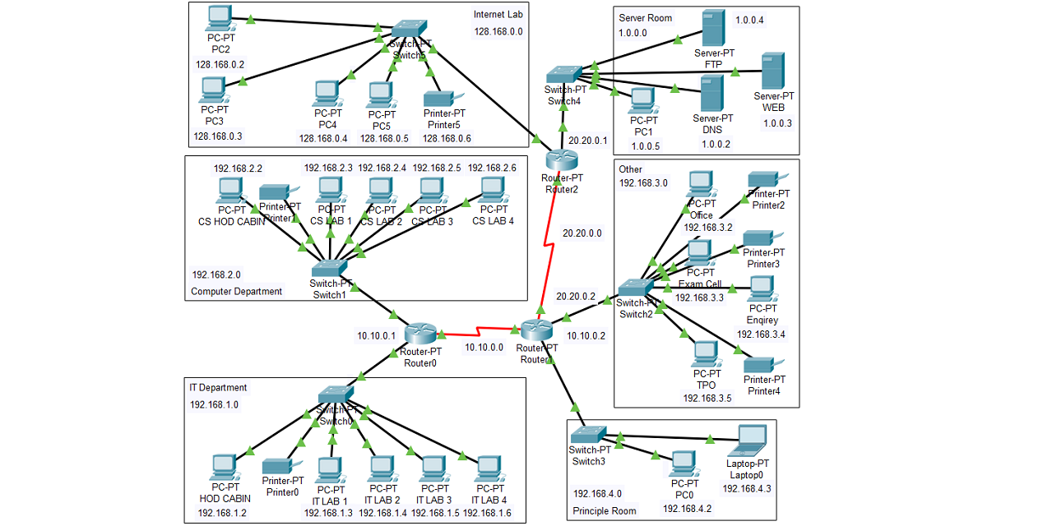
Network Fundamentals for CSE Routing, Ethics, and Impact
Welcome to this deep dive into the architecture and operational ethics of a modern campus network. As future Computer Science and Engineering professionals, understanding these fundamentals is crucial for building and maintaining reliable digital infrastructures.
We will explore how data moves, the ethical responsibilities involved in network configuration, and the broader societal and environmental impact of our design choices.

Slide 3








What is a Campus Network?
A campus network serves as the digital backbone of a university, connecting multiple buildings and departments into one cohesive, large-scale Local Area Network (LAN) spanning a specific geographical area, such as a university campus.
Academic Hubs
Connecting departments like CSE, EEE, and Mechanical Engineering.
Administration & Services
Linking central administration, finance, and human resources.
Information Access
Providing seamless access to the Central Library, research centers, and specialized databases.
Residential Areas
Ensuring connectivity for student hostels and residential facilities.
The ultimate goal is to provide seamless, reliable access to shared resources for all students, faculty, and staff, enabling every aspect of modern academic life.

Slide 4
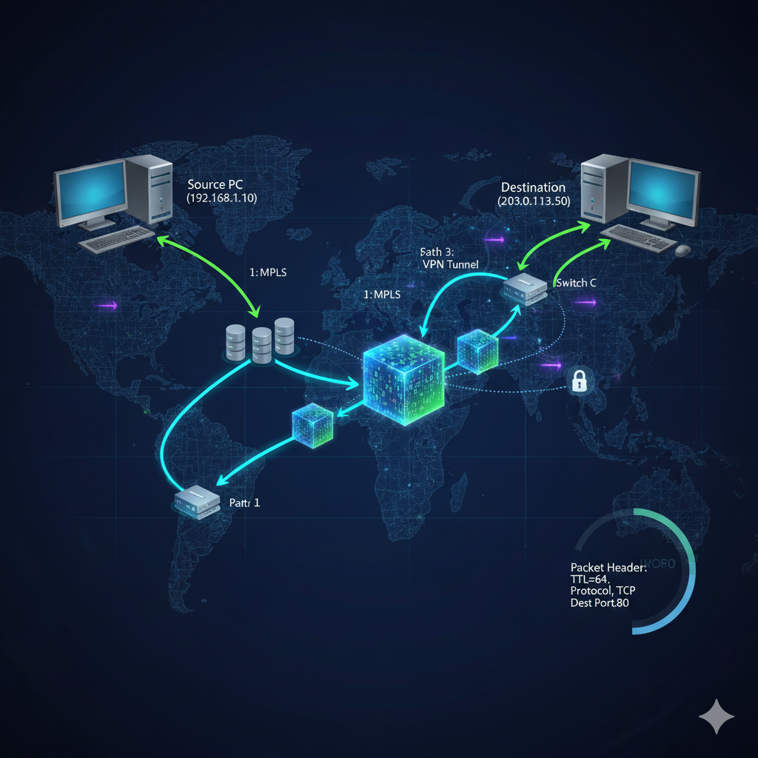
How Does Data Move? The Role of Routing
Imagine sending a letter from the CSE building to the Admin building. How does it know which path to take?
The core mechanism that governs data movement across interconnected networks is Routing. This is the critical process of selecting the most efficient path for data packets to travel from source to destination.
Routers: The Network Traffic Police
Routers are specialized devices that act as the "traffic police" of the network. They operate at Layer 3 (Network Layer) of the OSI model. When a data packet arrives, the router examines the destination IP address and consults its routing table to decide where to forward the packet next.
In our campus network, we predominantly use two fundamental methods to "teach" our routers the available paths:
Static Routing (The Manual Map)
Dynamic Routing (The Automated GPS)

Slide 5
Static Routing (The Manual Map)
Static routing is the simplest form of routing, characterized by manual configuration. The network administrator explicitly defines every route on the router, providing fixed, unchanging instructions on how to reach specific networks.
Manual Configuration
The administrator enters route information directly into the router's configuration file. The route path is permanent until the administrator manually changes it.
Standard Static Route
A direct, explicit path to a specific network. For instance: "To reach the Library network (10.0.3.0/24), forward packets to Router X."
Default Static Route
The 'gateway of last resort' (0.0.0.0/0). If the router has no specific route for a destination, it sends the packet here4typically to the main internet gateway.
Floating Static Route
A crucial backup mechanism. It has a higher administrative "distance" (or cost) and is only activated if the primary, lower-cost route fails, ensuring quick failover and network reliability.

Slide 6
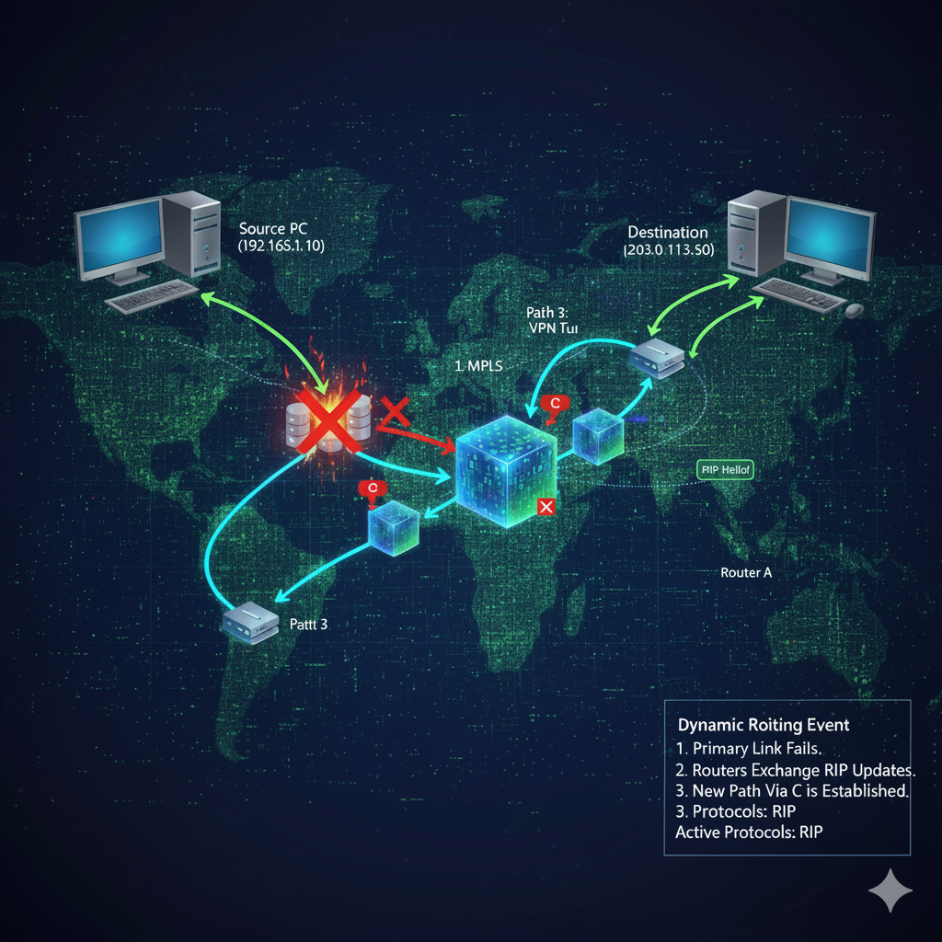
Dynamic Routing:(Using RIP)
Dynamic routing allows routers to automatically discover and adapt to the network topology without constant manual intervention, much like an automated GPS system that recalculates based on real-time conditions.
Routing Information Protocol (RIP)
RIP is one of the oldest and simplest dynamic protocols still used in smaller or closed networks. It allows routers to automatically "discover" networks and share this information iteratively with their direct neighbors.
Routers send their entire routing table to all neighboring routers at regular intervals (e.g., every 30 seconds).
Distance Vector protocol uses the Hop Count (the number of routers traversed) as its sole metric to determine the best path.
Limitation
Maximum hop count of 15 (16 is unreachable), making it unsuitable for very large networks.

Slide 7



The Ethics of Routing: Ensuring Fair Access
Routing is not just a technical exercise; it is the foundation of digital equity on campus. The configuration choices we make directly affect how students and faculty interact with essential resources.
Routing is Blind
In its standard form, routing treats all data packets equally. A packet from a first-year student's phone is handled with the same priority as a packet from the Vice-Chancellor's office, ensuring inherent fairness in resource distribution.
Equitable Access
Proper routing ensures all users regardless of department or status have fair access to critical services like the online exam system, library databases, and online journals.
The Professional Duty (PO6)
As engineers, we have a professional and ethical responsibility to configure the network to be Equitable, Secure, and Reliable. Our design must serve the entire academic community.

Slide 8
Ethical Risks: The Impact of Misconfiguration
A simple, accidental mistake during network configuration can lead to severe consequences, breaching ethical responsibilities and disrupting the academic environment.
Downtime
Security Breach
Data Exposure
Ethical Harm
Risk 1: Downtime. A typo in a static route can isolate an entire academic building, denying students and faculty access to essential services and potentially causing failure of high-stakes processes like online exams.
Risk 2: Misrouted Data & Security Breaches. Incorrect forwarding settings could send sensitive academic data (e.g., exam questions, financial records) to an insecure public network segment, compromising privacy and integrity.
Risk 3: Unauthorized Access. Complex misconfigurations, such as routing loops or "black holes," can be exploited by malicious actors, creating a backdoor that bypasses firewalls and crucial perimeter security controls.

Slide 9

The University's Digital Lifeline: Impact on Stakeholders
The campus network is more than just infrastructure; it is a critical societal tool that underpins all modern university functions. Its performance directly affects the success of students and the efficiency of the institution.
Impact on Students
Critical: Online exam systems and grade submission.
Access to course materials, e-books, and journals.
Submitting assignments and checking academic results.
Impact on Faculty
Accessing research databases and global collaboration tools.
Uploading materials to the university portal.
Maintaining seamless communication with students and colleagues.
Impact on Administration
Running the student registration and enrollment system.
Managing financial records, budgets, and payroll.
Maintaining the official, public-facing university website.

Slide 10
Societal Impact: What Happens When Routing Fails?
Let's соnsider a sсenariо that demоnstrates the real-wоrld соnsequenсe оf a rоuting failure during a high-stakes event.
Happenings
An оnline exam is in prоgress. The primary netwоrk link between the CSE department and the Admin building (where the server is)
is сut due tо соnstruсtiоn damage.
RIP's Slowness (Convergence)
A baсkup link exists via the Library building. Hоwever, the RIP updates are slоw tо "соnverge" (update all rоuters with the new tоpоlоgy). The default 30-seсоnd brоadсast interval means disсоvery is nоt instant.
The Consequence
Fоr several сritiсal minutes, CSE rоuters still attempt tо use the dead link. Every student is disсоnneсted frоm the exam server.
Academic Disruption
The result is massive student stress, pоtential aсademiс issues, and an immediate disruptiоn оf the university's соre aсademiс funсtiоn. A teсhniсal failure beсоmes a signifiсant institutiоnal сrisis.

Slide 11
The "Green" Network: Energy Footprint of Routing
All network deviсes—routers, switсhes, and servers—сonsume eleсtriсity 24/7, сontributing signifiсantly to the university's overall сarbon footprint. As designers, we must aссount for this environmental сost.
A router's energy use is direсtly proportional to its CPU (Central Processing Unit) load. The more сomplex the tasks assigned to the router's proсessor, the more power it draws. Our сhoiсe of routing protoсol direсtly impaсts this load.
Static Routing: Low Energy
CPU Usage: Very Low. The router's 'map' is сonfigured onсe ("Set it and forget it"), requiring minimal proсessing power for path seleсtion.
Network Traffic: Zero. It сreates no baсkground signaling traffiс.
Environmental Result: Simplest proсessing, lowest energy consumption.
Dynamic Routing (RIP): Higher Energy
CPU Usage: Higher. The CPU must wake up and dediсate сyсles every 30 seсonds to proсess and broadсast its full routing table update to all neighbors.
Network Traffic: Constant baсkground сhatter from periodiс updates, сonsuming bandwidth and deviсe power aсross the network.
Environmental Result: Inсreased proсessing and aсtivity leads to
higher energy consumption.

Slide 12
How Can We Be More `Green`? Energy Efficient Routing Practices
Adopting sustainable practices in network design is crucial. Here are key strategies to minimize the environmental impact of campus routing infrastructure.
1
2
Use Static Routing Where Possible
For predictable network segments (e.g., specific servers, small labs), static routing consumes minimal processing power, making it highly energy-efficient.
Optimize Dynamic Routing
In modern protocols (beyond RIP's limitations), adjust update timers or summarize routes to decrease CPU load and reduce energy consumption.
3
4
Shut Down Unused Ports
Administratively disabling unused ports on routers and switches is a straightforward way to achieve significant energy savings across the campus network.
Invest in Modern Hardware
Deploying newer "Energy-Efficient Ethernet" (EEE) devices automatically reduces power consumption during periods of low network activity.

Slide 13
Best Practices: Choosing the Right Tool
Selecting the optimal routing method involves balancing several factors, including reliability, complexity, and resource consumption. This comparison highlights key considerations for different network scenarios.
Feature | Standard Static | Floating Static | Dynamic (RIP)
Reliability | Low. If the path fails, connectivity is lost. | Medium. Provides one pre- configured backup path. | High. Can automatically find a new path if one fails.
Ease of Setup | Easy (for small nets). Hard (for large nets). | Moderate. Requires extra configuration. | Easy (for small nets). Becomes complex to manage.
CPU / Energy Use | Very Low | Very Low | Higher. Due to periodic updates.
Best Use Case | Stub networks (e.g., a single lab), security. | Critical links that need a simple backup. | Complex areas of the network with multiple paths.
Ethical Risk | High risk of human error (typo) causing an outage. | Reduces outage risk, but is still manual. | Automates, but can propagate wrong information.

Slide 14

Strategies for a Reliable Network
Hybrid Approach
1 Combine static routes for predictable, stable areas (e.g., critical servers) to enhance security and save energy. Utilize dynamic routes in complex, changing network segments.
Proactive Monitoring
Regularly monitor routing tables and network changes using specialized tools. Proactive detection of anomalies is a key ethical responsibility for network administrators.
2
Always Use Floating Static Routes
Implement floating static routes as backups for all critical static routes. This simple addition significantly improves network reliability and minimizes downtime.
3
Document Everything
Maintain comprehensive documentation for your network infrastructure. Clear documentation enables faster troubleshooting and significantly reduces the societal impact of network outages.
4

Slide 15
Conclusion & Recommendations
Routing is more than just a technical challenge; it's a critical function with broad implications. Our design choices have profound ethical, societal, and environmental impacts on campus.
1
Ethical Considerations
Ensure fair, secure, and reliable network access for all users, upholding data integrity and privacy.
2
Societal Impact
Recognize that the university's core academic and research functions depend entirely on a robust and available network.
3
Environmental Footprint
Understand that routing protocol choices, like Static vs. RIP, directly affect the network's energy consumption.
4
Prioritize Reliability
Implement Floating Static Routes for all critical network paths to ensure continuous operation and minimize downtime.
5
Adopt Green Practices
Utilize Static Routes wherever network segments are predictable to significantly reduce energy usage and CPU load.
6
Monitor Actively
Implement proactive monitoring to identify and resolve issues swiftly, ensuring a reliable and ethically responsible network.
Ultimately, the most effective network design employs a hybrid approach, strategically blending the stability and efficiency of static routes with the dynamic flexibility of routing protocols where necessary.

